Slide 1
MAHARISHI INTERNATIONAL UNIVERSITY
1971-1995
MAHARISHI UNIVERSITY
of
MANAGEMENT
Engaging the Managing
Intelligence of Nature

Slide 2
Lab 6:
Observer Pattern

Slide 3
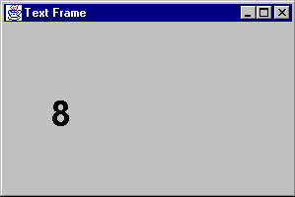
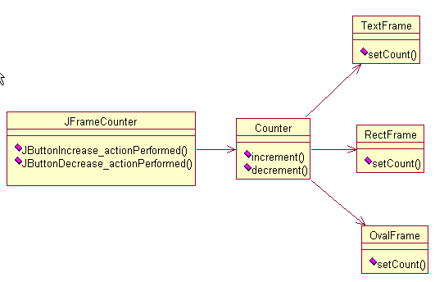
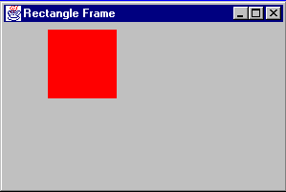
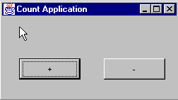
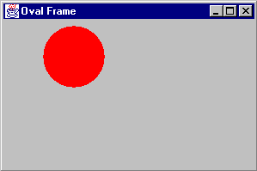
Observer : Lab

Slide 4
Observer : Lab without the observer pattern
public class Counter
{
...
public void increment(){
count++;
textframe.setCount(count);
rectframe.setCount(count);
ovalframe.setCount(count);
}
public void decrement(){
if (count >0){
count--;
textframe.setCount(count);
rectframe.setCount(count);
ovalframe.setCount(count);
}
}
}
Adding a new view
Change the counter object

Slide 5
© 2005 Maharishi University of Management, Fairfield, Iowa, USA
This tape may not be copied, duplicated, or distributed without written consent from Maharishi University of Management, Fairfield, Iowa, USA.

